Slide 1

CHILDREN WELFARE AND DEVELOPMENT
- Yarragunta Sai Charan Reddy

Slide 2
INTRODUCTION
Children are usually the main targets, who suffer in a number of ways because they are weaker, helpless and economically dependent.
As per the report of census (2011) Children with the age group between 0-6 constitute around 158 million of the population of India. These children are our future human resource of our country. They need to be protected and cared.
Children are the hope of their parents and simultaneously important assets for future development of any nation. Therefore, every nation must pay full attention to its children to ensure that they are given proper care and protection for their development.
This study was undertaken for two purposes—to gain insight into the issue of over-representation from the child welfare community, and to examine the programs and practices child welfare agencies are implementing to serve children and families of collar.

Slide 3
CAUSE OF PROBLEM
Now a days many children are dying and facing many problems, there are many reasons for their deaths.
India's children face some of the harshest conditions anywhere in the world. They suffer from the mistakes of their parents, the ignorance of an apathetic system, and the lack of a proactive support system.
There are many problems child are facing now a days. These are the main problems that children are facing now a days.
Child Marriage
Gender discrimination
Child labour
Malnutrition
Sexual assault
Orphan

Slide 4
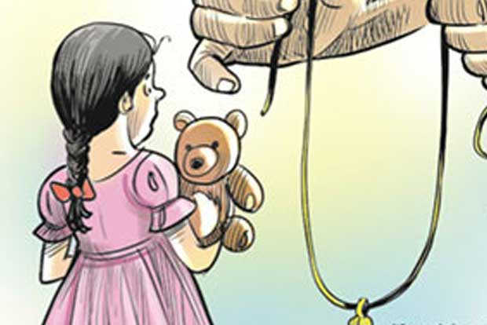
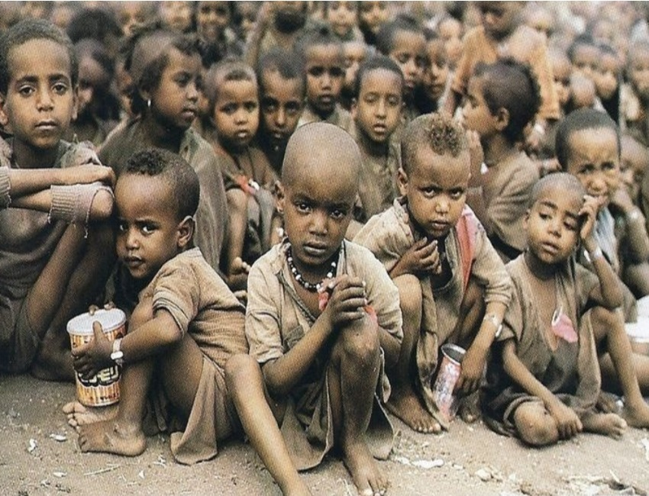
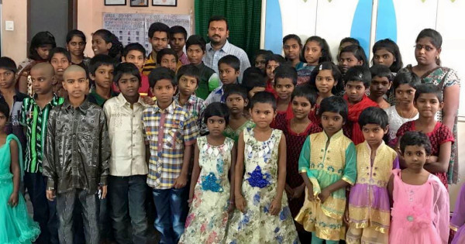
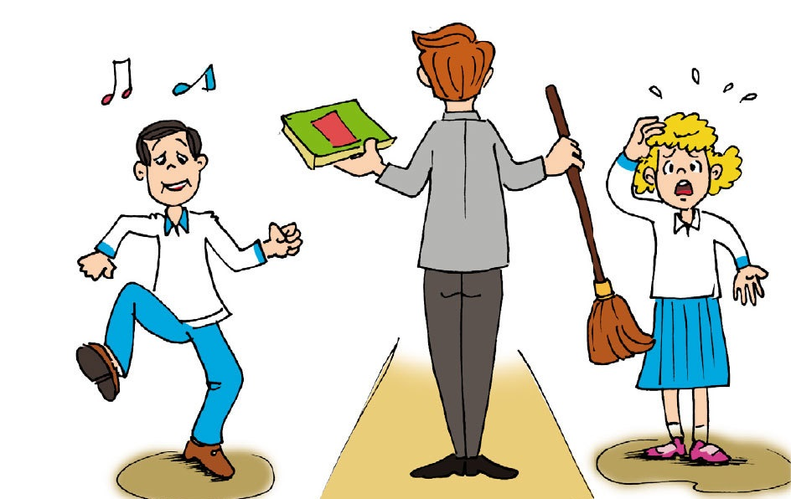
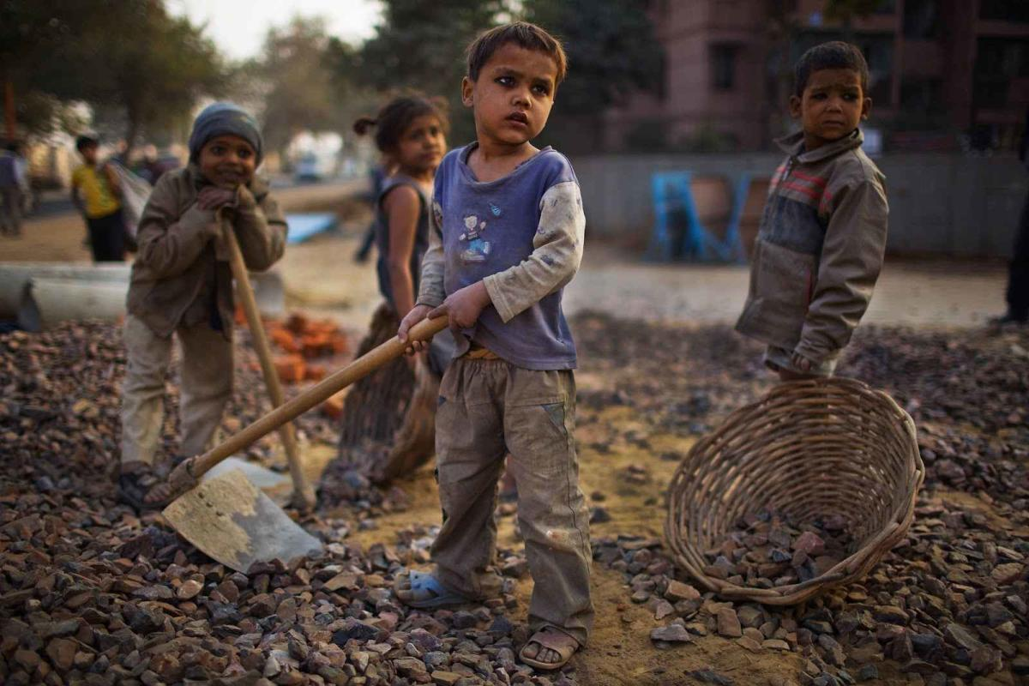

Slide 5
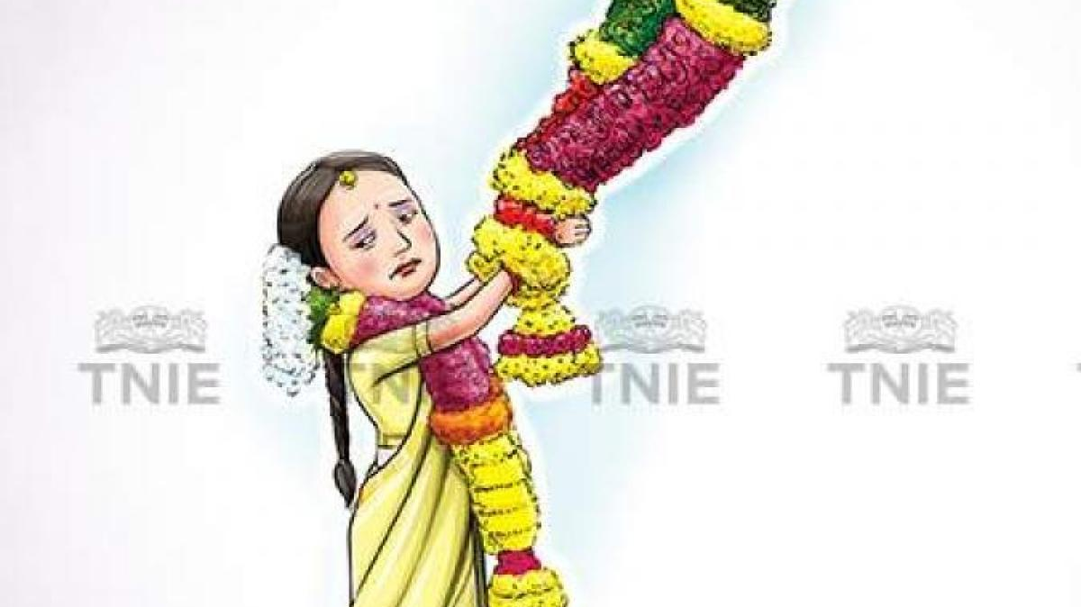
CHILD MARRIAGE
Child marriage is a curse as it violates the rights of children; it affects both boys and girls, but it is more common among girls.
As per the report of DISE (District Information System for Education )42% of married women in India were married as children.
As per the report of UNICEF (United Nations International Children’s Emergency Fund) 1 in every 3 child brides in the world is a girl in India.
Child marriages often occurred throughout history and are still prevailing due to variety of reasons including:
Poverty
Insecurity
Political and financial reasons
Lack of education
Gender inequalities
Inadequate implementation of the law

Slide 6
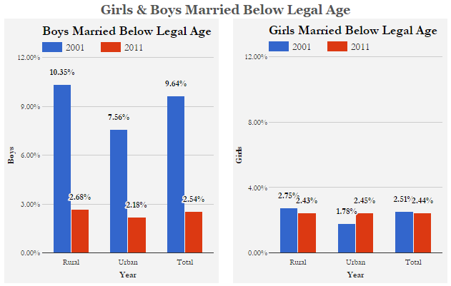

Slide 7

GENDER DISCRIMINATION
The immense problem that children are facing today.
Gender inequality is mainly done for girl child That in many parts of India, the birth of a girl child is not welcomed is a known fact. It is a known fact too, that discrimination starts from even before the girl child is born and sometimes, she is killed as a foetus.
When we compare the sex ratio of India, only 908 girls are there for 1000 boys. But despite such progress, even today, the girl child is discriminated against in most Indian households.
A girl child is considered as a burden and is often not even allowed to see the light of the world.
Child marriages and gender discrimination both are considered as a same issue and both are main issue for girl child. They are:
Poverty
Lack of education
Political and financial reasons
Inadequate implementation of the law

Slide 8
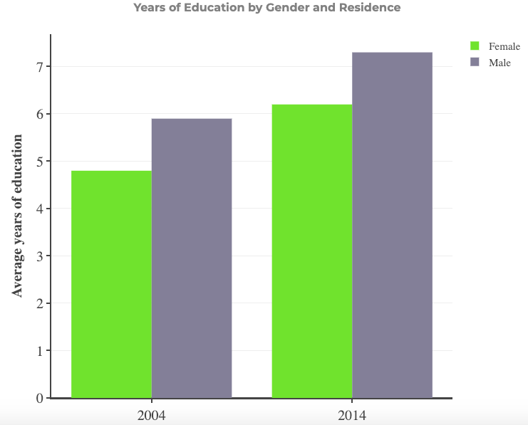

Slide 9
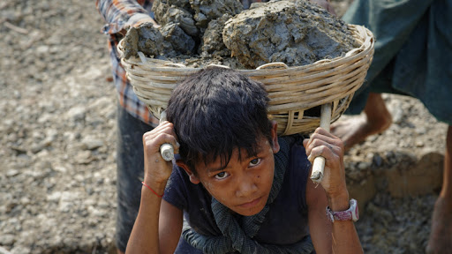
CHILD LABOUR
Many children are facing problems at workplace and some children die at workplace as they work in mines, due to blasts in mine many respiratory problems are facing.
Poverty is certainly the greatest single force driving children into the workplace. Income from a child's work is felt to be crucial for his/her own survival or for that of the household.
It is also due to inadequacies and weaknesses in national educational systems.
Child labour is also like a traditional work follows from their parents to children.
Various causes of child labour like the curse of poverty, lack of educational resources, Social and economic backwardness.

Slide 10
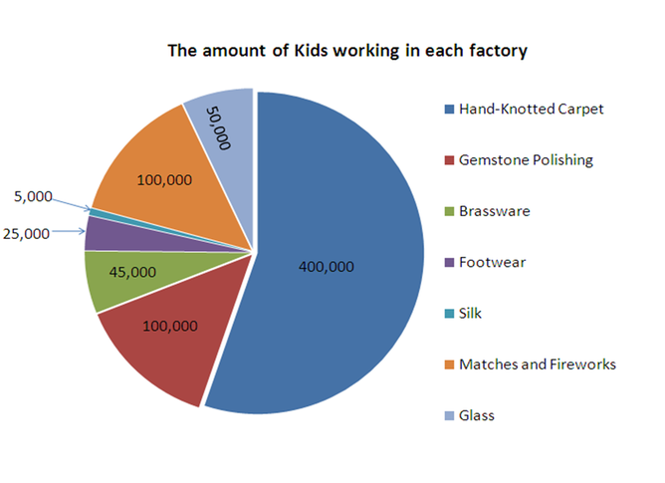

Slide 11
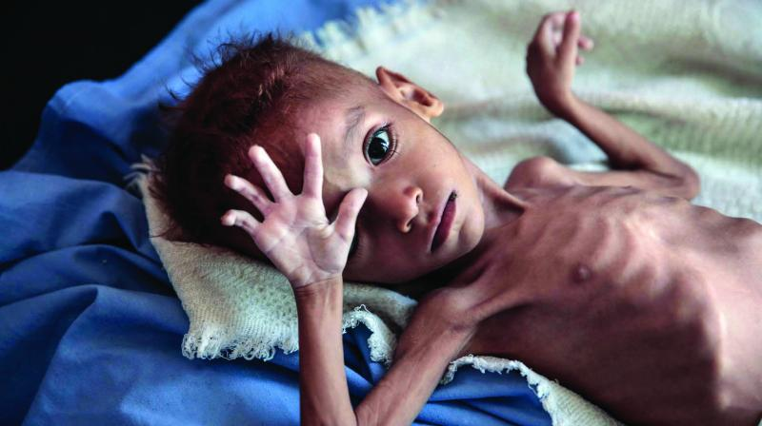
MALNUTRITION
Malnutrition is the result of inadequate dietary intake, disease, or both. Disease contributes through loss of appetite, malabsorption of nutrients, loss of nutrients through diarrhoea or vomiting.
Malnutrition (undernutrition) is caused by a lack of nutrients, either because of a poor diet or problems absorbing nutrients from food.
It is a major cause of child morbidity and mortality.
According to UNICEF the main causes of childhood malnutrition can be categorized into three main underlying factors which are household food insecurity, inadequate care and unhealthy household environment, and lack of health care services.

Slide 12
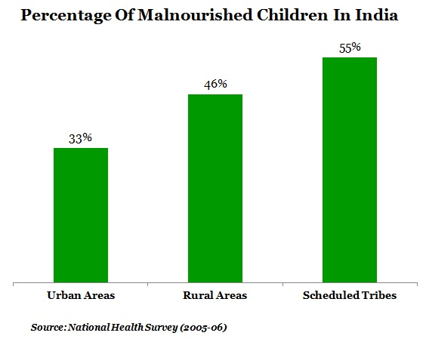
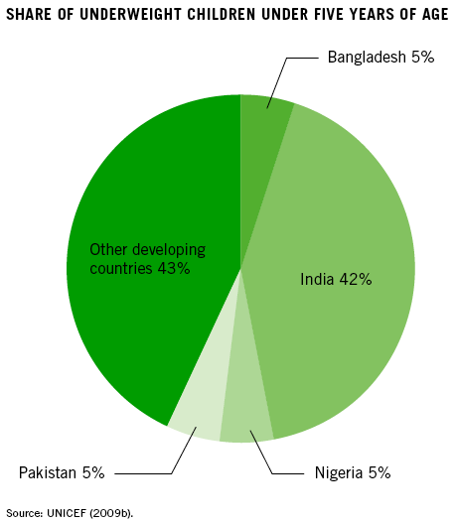

Slide 13
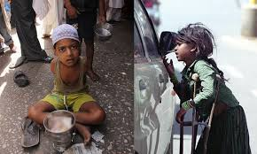
FORCED BEGGING
Forced begging is a multi-million-rupee underground industry in our country which abuses over 3 lakh children. They use all means to force the children to beg from drug addiction to mental, physical, and sexual violence.
Most children beg because they and their parents are very poor, and some have lost their parents due to death or desertion.
Forced begging is often imposed by family members, with parental power leveraged over a child to ensure that begging is carried out.
Children are being forced and tortured and send them for begging on streets

Slide 14
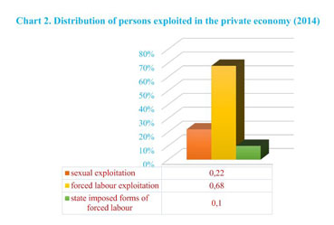

Slide 15
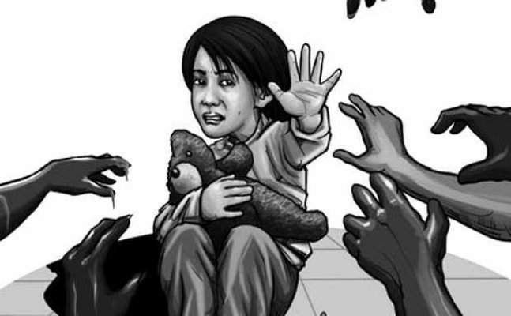
SEXUAL ASSAULT
It is a form of child abuse in which an adult or older adolescent uses a child for sexual stimulation. There are many reasons for sexual abuse:
Children in foster care, adopted children, stepchildren.
Physically or mentally handicapped children.
History of past abuse.
Poverty.
War/armed conflict.
Single parent homes/broken homes.
Parent(s) with mental illness, or alcohol or drug dependency.

Slide 16
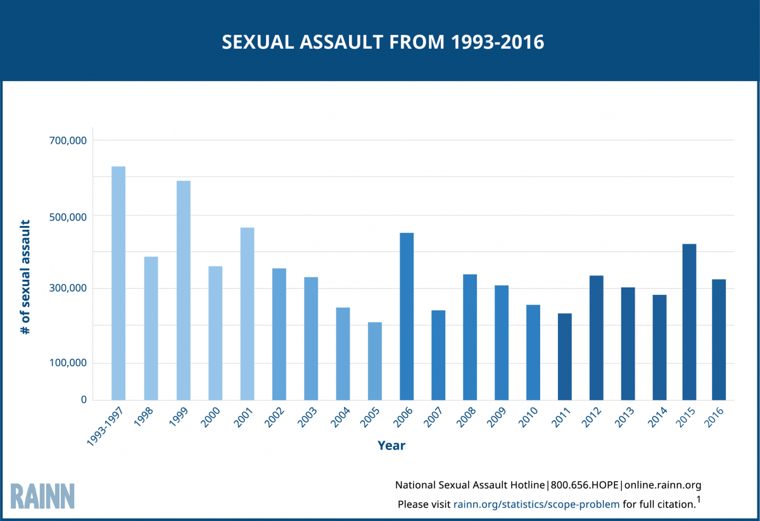

Slide 17
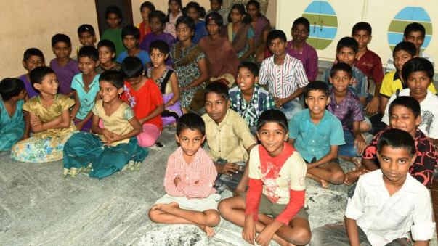
ORPHAN
As per the report of UNICEF India has more than 25 million orphan and abandoned children.
Today’s orphan crisis currently affects more than 140 million children across the world. This number is staggering, leading many to wonder how and why this has happened. Here are five terrible causes of the global orphan crisis:1. HIV/AIDS
2. Poverty
3. Difficult in adoption
4. War
5. Corruption

Slide 18
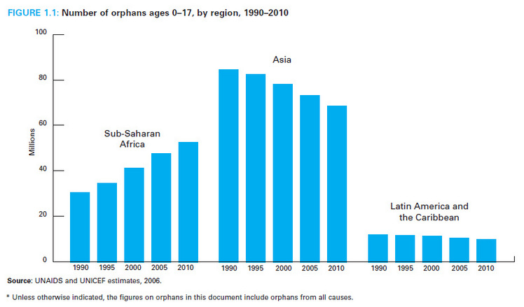

Slide 19
OBJECTIVES TO BE ACHIEVED
To improve girl child literacy and welfare.
To empower girl child by providing education.
To improve the nutritional and health status of children in the age-group 0-6 years.
To provide a child-friendly environment that is safe, secure, caring and stimulating.
to eliminate child mortality rate and child marriage cases in society.
to overcome the problem of decline in child sex ratio.
to eradicate child mortality and child marriage in society.
to raise the status of the girl child in the family and in the society and to change the mindsets of the people for proper rearing of the girl children and providing them the right to birth and the right to survival.

Slide 20

SOLUTIONS FOR OBJECTIVES
There are many solutions for problems facing by children and their development. Government initiated many rights for children and many laws for children. It is our duty to follow them. There are many laws and rights for children.
There are many governmental and non governmental organisation works for welfare and development of children by providing certain schemes and development projects.
UNITED NATIONS CONVENTION ON THE RIGHTS OF CHILD(UNCRC)
In the history of human rights, the rights of children are the most ratified. The United Nations Convention on the Rights of the Child (UNCRC) defines Child Rights as the minimum entitlements and freedoms that should be afforded to every citizen below the age of 18 regardless of race, national origin, colour, gender, language, religion, opinions, origin, wealth, birth status, disability, or other characteristics.
These rights encompass freedom of children and their civil rights, family environment, necessary healthcare and welfare, education, leisure and cultural activities and special protection measures.
There are 42 articles for children and development of children.

Slide 21
INTEGRATED CHILD DEVLOPMENT SERVICES SCHEME(ICDS)
ICDS Scheme represents one of the world’s largest and most unique programmes for early childhood development.
The objectives are sought to be achieved through a package of services comprising:
supplementary nutrition
immunization
health check-up
pre-school non-formal education
Nutrition & health education
Welfare schemes by A.P government
Amma vodi
Jaganna vidya Deevena

Slide 22
Other welfare schemes by central government and state government
Welfare schemes by central government
Aapki beti hamari beti
Sukanya Samriddhi Scheme
Welfare schemes by other state government
Chief Minister Rajshree Yojana by Rajasthan state
Chief Minister’s Girl Child Protection Scheme by Tamilnadu state
Government initiated many welfare schemes and development projects for children. It is our duty to follow and make them understandable about their laws, rights for their protection.
There are some non-governmental organisations which works for development of children by following the laws and rights of children. one such NGO is Human and Natural-resource Development Society (HANDS).

Slide 23
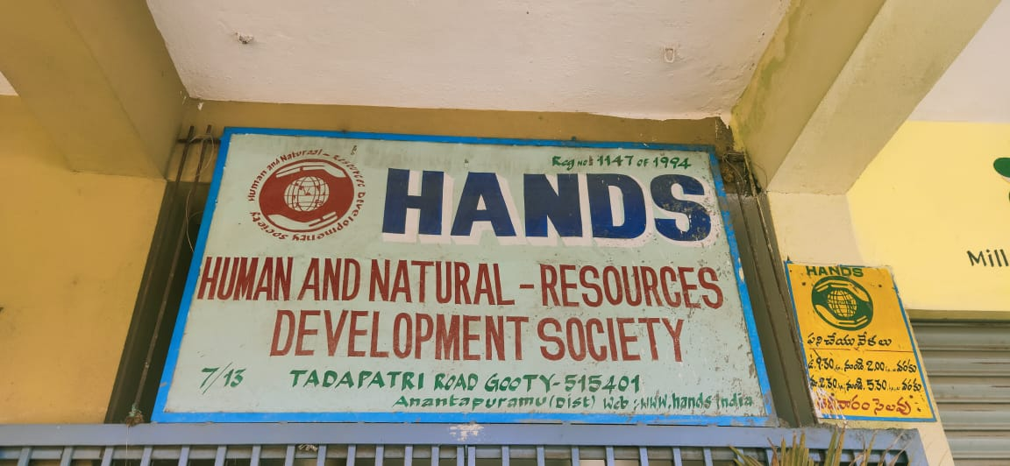
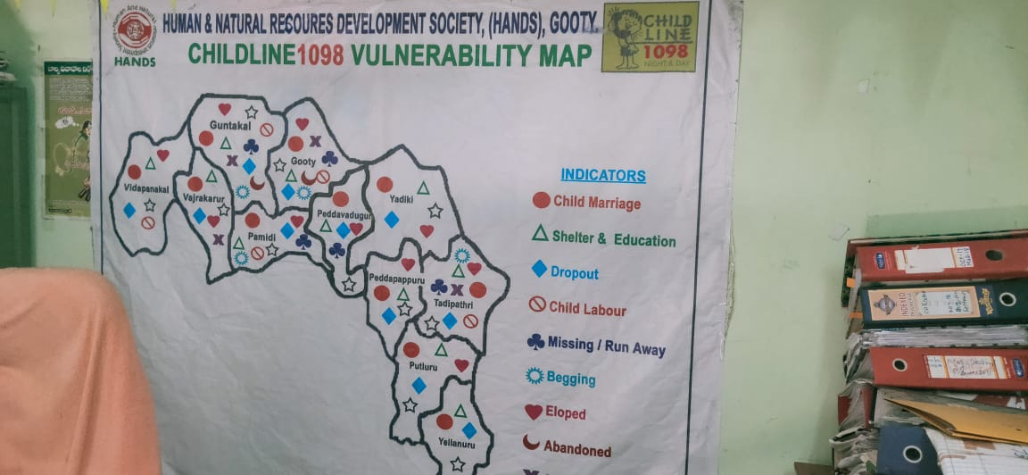
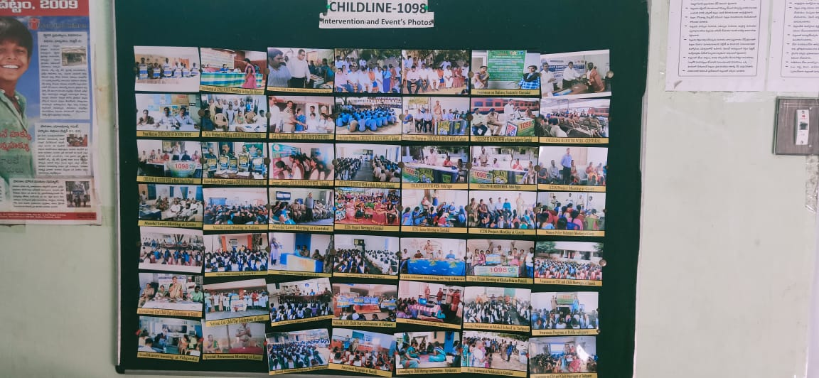
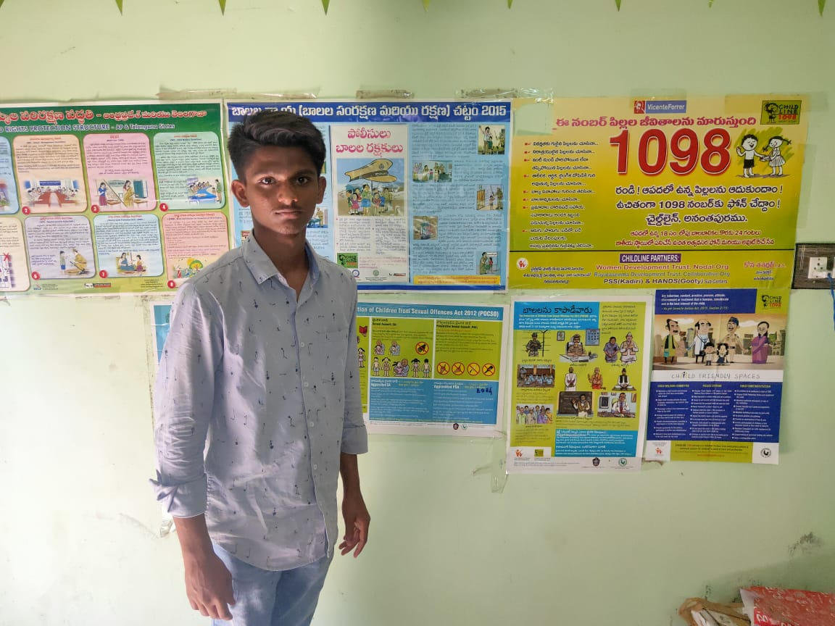
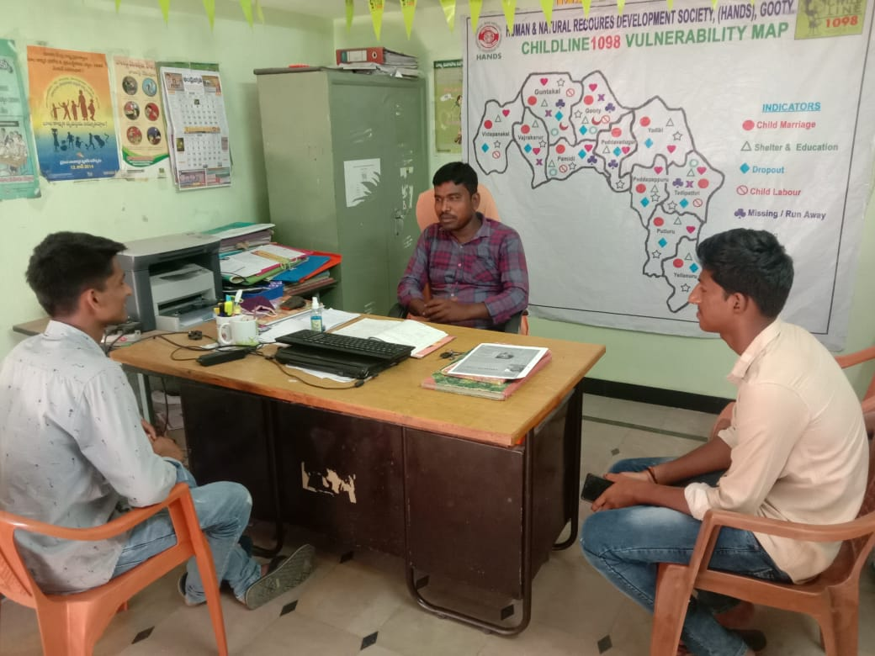

Slide 24
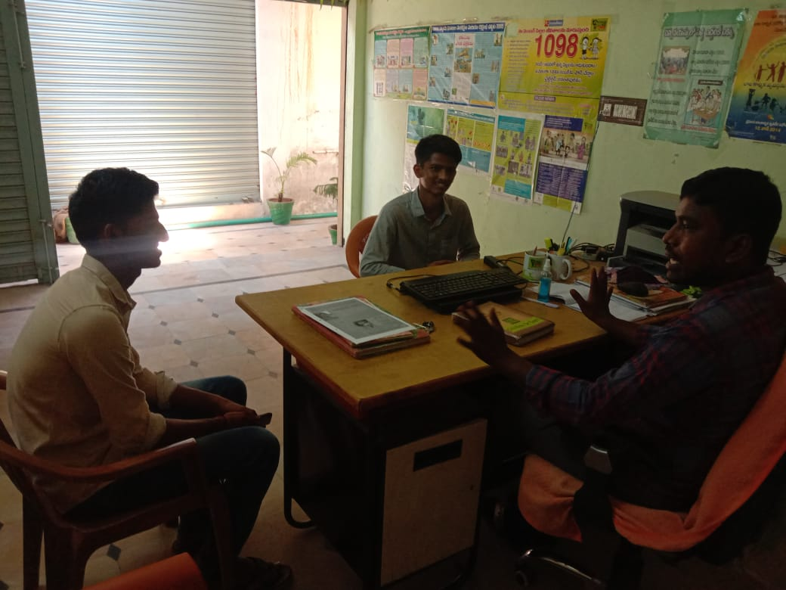
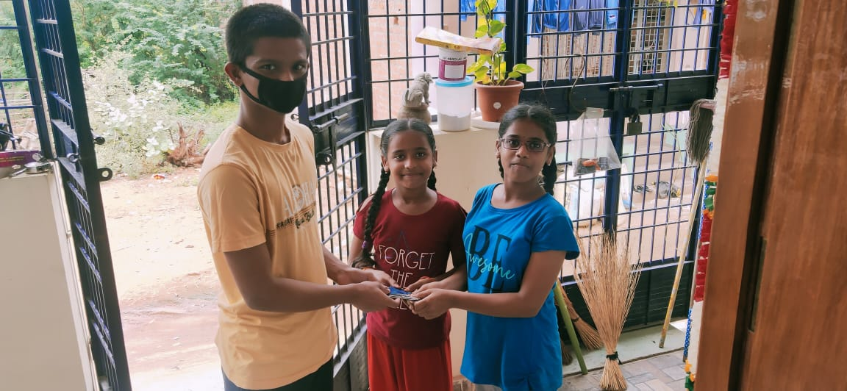
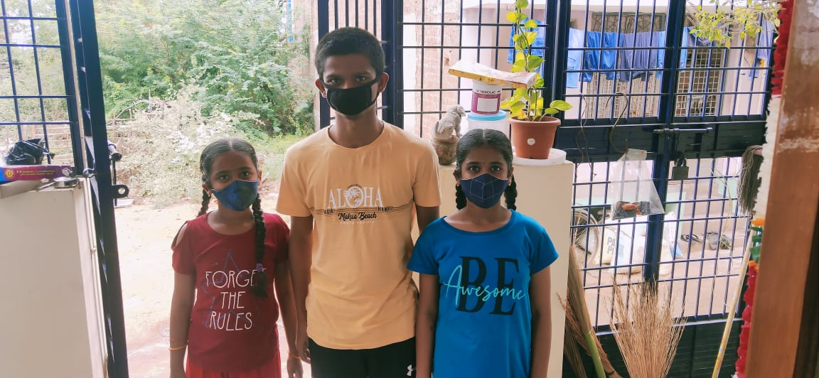
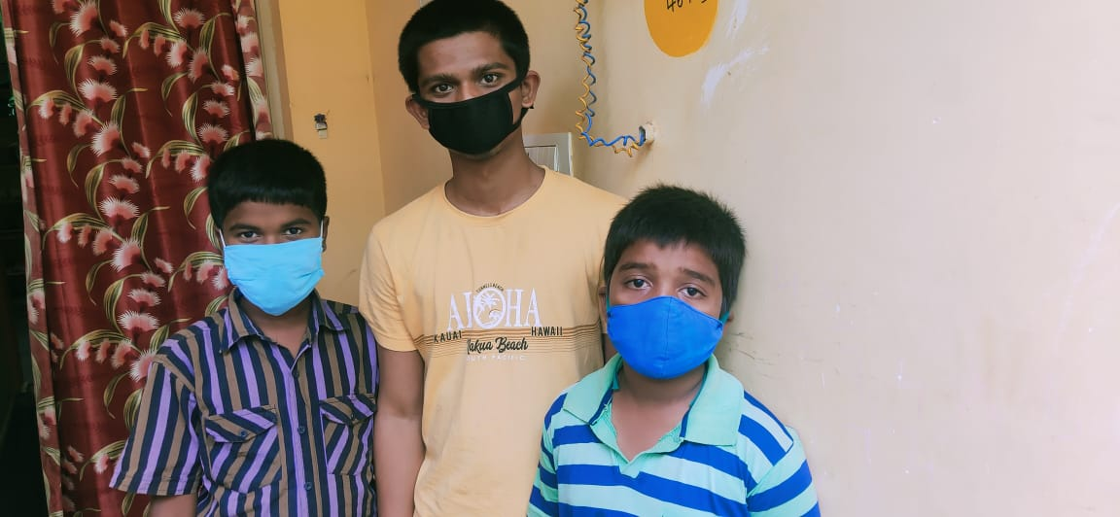
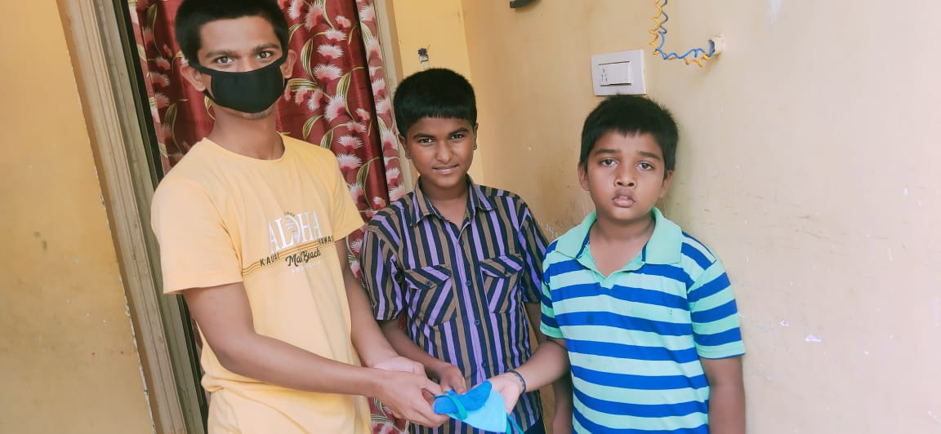

Slide 25

THANK YOU

